Slide 1
SAC Student Life SIG Leader Training
FALL 2018 PRESENTATION
Information provided by SAC StudLi:
Laura Brush, Laura Logozzo, Perry Leung, and Prerna Bhat

Slide 2
Agenda for today’s training
SIG Leader Training Schedule
2:00-2:15pm – SAC Budget Guidelines & Non-speaker Events
2:15-2:45pm - Minna Brown, Melanie Quigley, and Yolanda Quinones - Speaker Events
2:45-2:50pm – Alyssa Student – Event Planning & Calendaring
2:50-3:00pm – Jennifer Truong & Donna Williams - Business Office
3:00-3:10pm – Ladd Flock – Career Development - CDO
3:10-3:20pm – Thomas Easley - EQUID
3:20-3:30pm – General Questions

Slide 3
Key Points from Budget Guidelines
All funding will provided on an ad-hoc request basis
There are no SIG budgets at the beginning of the term
Reporting
If a receipt is not submitted within five days of an event, no other events will be funded until the receipts are submitted.
Event reports must be submitted within five days of an event. No other events will be funded until it is submitted.
No retroactive funding
Apply for funding before an event happens
There is no carryover
Money from a previous semester does not carry forward into the next.

Slide 4
What does SAC fund?
A discretionary budget of $120 is available to all active SIGs
Non-speaker events
e.g., workshops, tutorials, field trips, discussion forums, etc.
Speaker Events
Speaker events are now being funded through a new process. SIG leaders will have access to funding from SAC, the Community Events Fund, Learning Community funding and EQUID funding through a single process.
The new process is intended to streamline planning and enhance coordination of speaker events.
There will be SAC representation to review the speaker funding throughout the new process.

Slide 5
Non-Speaker Events Guidelines
SAC is encouraging creative development of non-speaker events for the Community
There are guidelines for Food, Supplies, and Student Travel for Non-Speaker Events
Total amount spent by each SIG for Non-Speaker Events are capped for the semester
Food: $300
Supplies: $200
For non-speaker events funded by SAC, please continue going to Nickelle and the Business Office to get access to the pcard for purchases

Slide 6
Maximize Your Funding
Collaborate with other SIGs to co-sponsor events
Co-sponsored events
The primary planning SIG receives the funding
Reach out to CDO, Class of 1980 (FES Alumni office)

Slide 7
Final Notes
We understand the Non-Speaker Event Budget Guidelines aren’t perfect, and are working to continually improve them. Please let us know any feedback that we can use to improve them, via the ad hoc form or through email.
SAC StudLi is excited to help support and work with SIGs to continue to put on exciting, diverse events on campus.

Slide 8
Questions?

Slide 9
FUNDING FOR SPEAKER EVENTS FOR STUDENTS
APPLICATION FOR FUNDING (AVAILABLE ONLINE)
SUPPORT STAFF: Yolanda Quinones, Asst. Dir. Strategic Initiatives
….sent to the Application Review Committee
APPLICATION REVIEW BY COMMITTEE
REVIEWERS: Asst. Dir. Of Strategic Initiatives, Asst. Director of Student Services, and SAC representative
…sent to the Funding Review Committee
Specialization & Learning Committee Funding LEAD: Minna Brown, Dir. of Academic Affairs | F&ES Community Events Conference & Events Funding LEAD: Melanie Quigley, Dir. of Strategic Initiatives | Office of Community and Inclusion Funding LEAD: Thomas Easley, Asst. Dean of Community & Inclusion
Notes:
@Application for Funding stage
Fill out and check invited speaker spreadsheet
Funding application form
Room reservation Form
@Application Review by Committee Stage
-Committee Reviews to make sure there isn’t overlap of speakers/events

Slide 10
Event Planning for Students
Reserve classroom/venue space in F&ES Room Reservation System (F&ES Calendar)
myFES > Room Request Form > Reserve a Room or Announce an Event
Joan McDonald receives/reviews request and mails Event Organizers the Room Reservation Request Form & Event Guidebook
Return the Room Reservation Form to Joan McDonald at joan.mcdonald@yale.edu
This must be completed and returned before your event can be confirmed!
Room Reservation Request Form will be sent to the appropriate F&ES Service Units:
ITS, Facilities, Communications, Business Office, and Student Services (Alyssa Student)
Email Alyssa Student, alyssa.student@yale.edu, to schedule a 30 minute intake meeting
Discuss details of event
Review Event Guidebook and checklist
Event Organizers are responsible for reaching out directly to the appropriate F&ES Service Units to submit service requests and schedule meetings as needed
Larger events/conferences; Event Organizers are required to attend a meeting with Service Units one week prior to the event

Slide 11
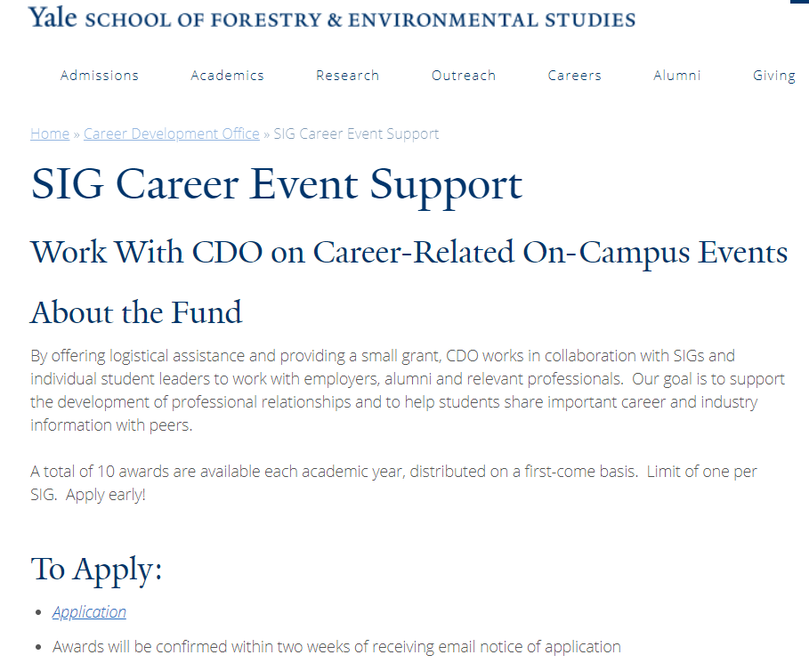

Slide 12
Business Office SIG Leader Training
September 14, 2018

Slide 13
What does the Business Office Do?
1. Provide Payment Options
Pcard** (University credit card)
**Preferred Method. No Need to Use your Own Money!
Request ACH/EFT, check, and wire payments
Reimburse YOU for out of pocket expense
Run Monthly Financial Reports
See a list of current transactions
Check remaining balances
3. Help navigate Yale’s Policies and Procedures
Notes:
Provide Payment Options
- Provide Pay for event expenses
- food, catering, conference fees, and many other types of purchases
- Expense reimbursement for on campus guest speaker
Set up suppliers in Workday
- The entire process can take days or weeks, depending on the goal. All of these steps can be confusing, but we are here to help guide you. Reach out to Business office sooner than later.
2. Financial Reports
- Transfer funds between SIG and other Yale accounts
3. Help you Navigate Yale policies and procedures
Contracts
Risk Management

Slide 14
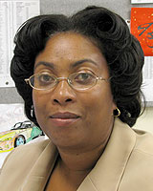
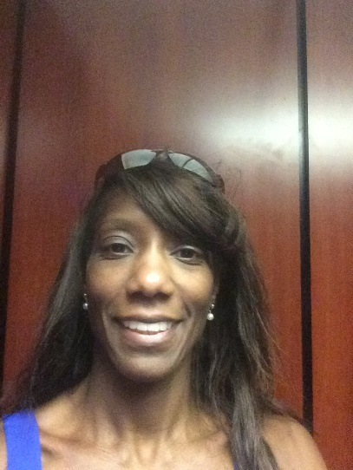
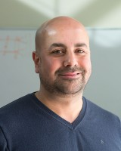
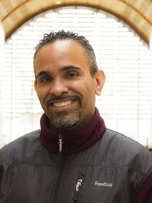
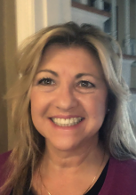
Business Office Contacts
Nickelle Gilbert | Handles All SIGs
Admin Assistant
Donna Williams
Asia | LUCY
ConBio | Stigma
ENERGY | YELA
COCO | La SIG
Environmental Media & Arts
Financial Assistants
Fawaz Alwash
Kroon Café | Politics
Westies | PhD
ROOTS | SAC
On the Margin
Sergio Gomez
EJAY | BE2
Fire SIG | Scope/Score
Forestry Club | YEW
Conservation Finance | Out in the Woods
The Spatial Collective | SCOPE/SCORE
TBD
CAFÉ | ISTF
TAT | SAF
HEY | IEME
RRAD (Disaster) | GROUNDED
Donna Redmond-Wirkus
Climate Change | Sage Magazine
Africa | NRX
EFFY | FES Music Project
Fresh and Salty | Toxic
Notes:
The Business office staff - there Names and emails are listed on the Bulletin board.

Slide 15
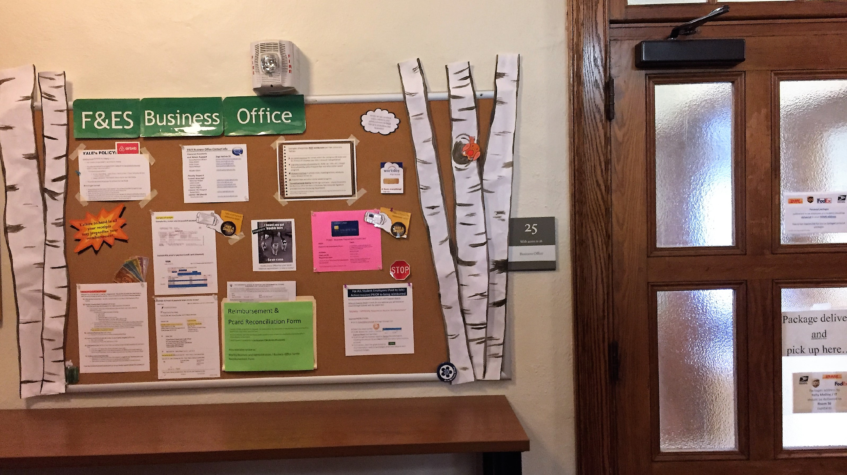
Where is the Business Office Team located?
Main Business Office Sage Rm 25
Nickelle Gilbert and Financial Assistants office
Visit the bulletin board for key instructions & updates.
Notes:
Where? The MAIN business office is located in Sage, room 25. Nickelle Gilbert is located in this office, she will direct you based on your request to other members of the Team.

Slide 16
Workday COA# the unique account number
Workday Charging Instructions, example of the full COA string
The COA# is needed for every reimbursement and/or purchase along with the approval from SIG leader.
No COA# & approval then No payment (no reimbursement, no Pcard)
Notes:
Account numbers at Yale are referred to as COAs. NOTE: assignee is not always required.
With your new knowledge of the business office, you will want to BE familiar with a common term you'll hear over and over at Yale, it’s . The Worktag is an account number, where expenses are charged. Whenever you are trying to pay or get reimbursed you will need this account number. Remember to always ask and get the Worktag

Slide 17
BEFORE YOU MAKE A PURCHASE:
Have your Planning Session
Know what you are buying prior to purchasing!
Research your catering options, travel options, etc.
Nickelle can assist with payment by appointment only, at least a week before your event.
When Purchasing you must make sure, as the President or Treasurer of your SIG, you supply your written (email) approval including the account to charge (a.k.a. “COA”) to the individual delegate.
Ensure your Delegate completes the FES reimbursement form
The form can be found here: https://environment.yale.edu/myfes/business-and-administration/
Notes:
After you have had the planning session
By now you’ve gone to Alyssa and come up with a budget plan for your event. Now you’re ready to spend!

Slide 18
Purchasing Options: P-Card
The Business Office has a credit card (P-Card) available for use by appointment request, email Nickelle Gilbert, nickelle.gilbert@yale.edu
In-Office use
- Purchase online via your laptop (i.e. Amazon, flights, hotels
Two Hour Offsite use
Available 9am – 4pm Monday through Friday
Leave ID while card it out of office
ID is provided in exchange for receipt
For ANY option SIG Leaders MUST always PROVIDE their delegate(s) with written approval to charge COA/account PRIOR to requesting reimbursement or payment!
Over the Phone
After hours dinner
Notes:
In-house use: bring written approval, completed reimbursement form, and purchase plans to the Business Office. ONLINE OR OVER-THE-PHONE payment can be made with the P-Card. Send a copy of the receipt to Nickelle!
Two Hour Offsite use: only during the hours of 9 a.m. – 4 p.m., Monday – Friday. Bring written approval, completed reimbursement form, and Yale ID to Business Office. The Business Office will hold your ID while you make your purchase. Turn in the P-Card and receipt to reclaim your ID.
Over the phone: You can call restaurants ahead of an after-hours dinner with the P-Card information if the card is needed outside of business hours. Bring written approval, completed reimbursement form, and purchase plans to the Business Office. Receipts must still be turned in to the Business Office!
In all these instances you’ll need to provide the Business Office with:
Written approval from leader
Completed reimbursement form
Receipts

Slide 19
Purchasing Options: P-Card
Important Notes!
If the P-Card is lost, it can take up to two weeks to be replaced. Everyone must be out of pocket and file for reimbursements during this time.
If a SIG loses the P-Card or does not turn in required documentation timely, that SIG’s P-Card privileges may be suspended for the semester.

Slide 20
Purchasing Options: Paying Outside Vendors
Paying people and suppliers outside of Yale is a two-step process:
The person or suppliers must be set up in Workday
The payment processed in Workday
*NOTE: Each step requires its own paperwork – See Nickelle ASAP
Yale has an online purchasing system to issue Purchase Orders and to streamline the payment process.
Purchasing Options: Contracts
Do not sign any contracts!!
Please forward all contracts to the Business Office for review and routing. Approvals can take several days for central office review and execution.
See Nickelle for assistance with any of this!
Notes:
Your vender needs to be entered into workday in order for them to be paid.
*** When you know ahead of time a PO should be created to streamline the payment process.
You are not authorized to sign any contracts on behalf of Yale University!

Slide 21
Yale Travel
Egencia offers a robust inventory of hotel, air, car and rail options.
Students to request a Username or set up assistance contact Nickelle Gilbert in Sage 25 or email directly: nickelle.gilbert@yale.edu
Features: Egencia ® TripNavigator. TripNavigator app provides the user with real-time travel alerts, flight displays, online check-in and other features that enhance the modern travel experience.
Web Address: Its Your Yale Travel Management
https://your.yale.edu/work-yale/travel-relocation-fleet/travel/egencia
Notes:
Some notes to keep in mind while spending for your various needs…
Holds reservation up to 24 hours, for example you can book it at 1 a.m. and come in at 3 p.m. and process the payment
Egencia is programmed to follow Yale’s policies, so there’s less for you (and us!) to worry about
Better security for credit card transactions (cards are often compromised)
Customer service for someone who is formally linked to a Yale account seems to be pretty good! Will match price if you have found a cheaper flight elsewhere.
Receipts are easily recoverable in the system
Who can use this site? Anyone in this room… but it doesn’t have to be a SIG leader, you can designate a person to work with Nickelle Contact Nickelle to be setup.

Slide 22
Yale’s Policy :
Guidelines to use Airbnb for lodging (as of FY19):
Yale travelers are permitted to use Airbnb for lodging.
The preferred method for arranging Airbnb lodging is the Yale Airbnb for Business platform, using a Yale email address.
To locate business platform
1. Its Your Yale website…
path:/ Home > Work at Yale > Travel, Relocation & Fleet > Travel > Hotels > Airbnb
2. google.com search “Yale Airbnb” click on the Its Your Yale Airbnb
The preferred method of payment for Airbnb is the Yale PCard.
How to get started: (instructions found on Its Your Yale website)

Slide 23
The Business Purpose
Every transaction submitted through Yale’s systems must have a complete business purpose.
It tells a story explaining the expense: WHO, WHAT, WHERE, WHEN, WHY, and HOW MANY.
Most of the people reviewing your transaction will not know what the purchase is without a complete business purpose.
This is part of the reimbursement form.
Notes:
HIGHLIGHT 5 WS

Slide 24
GOOD Business Purposes
Airfare for guest speaker Jane Doe to attend ISTF conference at F&ES on January 28 -30, 2018.
Catered lunch, and baked goods purchased for Energy SIG Solar Event September 8, 2018, for approximately 50 F&ES students, staff, and faculty.

Slide 25
BAD/UGLY Business Purposes
To teach in India
Research in Washington, DC
Dinner with SPPT on LCT for GPD
Conference
Florist
Business Trip
Your expense cannot be processed without a complete business purpose!

Slide 26
Funding Transfers
The Business Office can transfer funds between SIGs and other F&ES departments.
If another SIG or F&ES department agrees to contribute funds to your SIG, you must send that agreement (including $ amount) to your Financial Assistant for the transfer to be made.
If a Yale organization or department outside of F&ES agrees to transfer funds to your SIG, the other organization or department must initiate the transfer.
Follow up on your transfers to be sure that you get all of the money you’ve been promised.
Notes:
Let someone know the transfer is needed and provide your COA

Slide 27
Cash/Check Handling
Cash and checks must be delivered to the Business Office on a daily basis. DO NOT store funds in your lockers – we have a safe in our office for this purpose!
If you turn cash in, get a written, signed receipt by the Business office!
We have a limited number of lockable cash boxes that you can use for your events. They are empty (you must arrange for your own change fund) and must be reserved in advance.
If you are holding a fundraiser for a non-Yale organization, the money you raise cannot be deposited into your SIG account – it must be identified in advance and deposited into a separate Yale account. Please contact the Business Office prior to your event for assistance.
Notes:
Daily basis hand in your cash/checks. Limited cash boxes available.
IMPORTANT – arrange for your own change fund.

Slide 28
Gifts/Donations to SIGs
If you receive a monetary gift from an outside entity, it must go through the F&ES Development Office to be processed.
If an outside entity wants a formal letter from the university acknowledging the gift, a value must be given to the gift donated, and it must be submitted to the Development Office for processing.
Notes:
If you receive outside funds please contact the Development Department, there is a process that must be followed before the funds can be used.

Slide 29
Monthly Financial Reports
Every month, a statement of your SIG account will be sent to the leaders of the SIG via your Yale email. (Check your SPAM folder!)
To learn to read and interpret these reports, contact your assigned Financial Assistant and make an appointment to review your report.
You are responsible for reviewing these reports and reconciling them against your own records of transactions.
If something seems amiss, contact your Financial Assistant for help.
Notes:
This statement includes a list of your current transactions and your remaining balance.
This is also where you check that a TRANSFER has been completed or you received funds you were promised.

Slide 30
Always Remember
PRIOR to payment we need COA#, SIG Leader Approval, and completed reimbursement form
Visit the Bulletin Board outside Sage Room 25 for key instructions and updates
The Business Office Team is here to help!
Notes:
So now that you have a brief overview of the office, Some things to remember…
There is a lot of information to process and different departments we work with. Things take time, schedule a meeting.
I'm sure we'll be seeing you soon! We are waiting to assist you - Thank you for your time!

Slide 31
Have a Great Year!
Questions?
Notes:
I'm sure we'll be seeing you soon! We are waiting to assist you - Thank you for your time!

Slide 32
Equity, Inclusion and Diversity
Making your SIG and Events bigger and better while subversively dismantling systems of oppression.

Slide 33
EQUID (We are here to help!)
EQUID is made up of staff, faculty and students and our mission is to "create a campus environment that pushes us to challenge ourselves and each other to:
cultivate an atmosphere of inclusion;
grow the cultural competency F&ES students, faculty, and staff
challenge systems of oppression
foster a space where a diversity of ideas, values, and perspectives are welcomed and respected.
http://environment.yale.edu/diversity/equid/

Slide 34
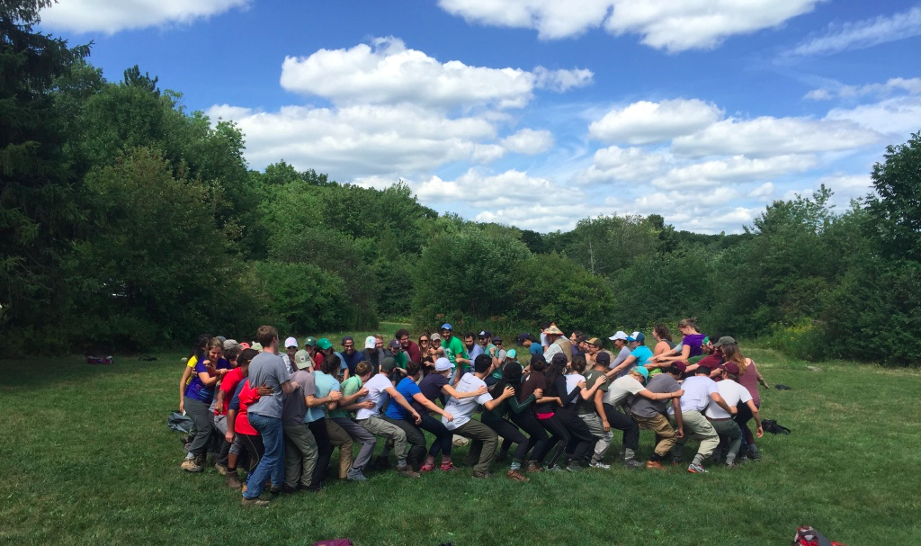
Our individual choices make our community

Slide 35
Think Ahead!

Slide 36
Things to think about:
Assess where you are. Aside from affinity-based groups, is your membership reflective of the identities represented in our larger community? If not, why not?
Who’s not coming and why?
Are you offering a range of speakers and perspectives?
Images, subtle messages, unintended/learned exclusion, implicit bias
Considering the way the event could be perceived and experienced by attendees and the broader community

Slide 37
Things to do
Scheduling meetings and events: consider holidays, alternate opportunities/conflicts, who consistently can’t come (Staff? Parents?). Time of day, day of week, venue. Try: change up days and times, consult a calendar of holidays, check the Yale and FES Calendars!
Venue: Physically accessible for people who use assistive devices, for whom walking is hard, who are carrying heavy stuff, etc. Transportation access for those without a vehicle, financially accessible for folks on a limited budget

Slide 38
Things to do
Posters/Images: an opportunity to present counter-stereotype imagery, and good to consider carefully
Who you advertise to
How you advertise: Posters, Facebook (some folks don't use, some groups are private), new email system **When posing images online provide a description of image and any text content**
What you say, intention vs. impact

Slide 39
Event-Specific Considerations
Food and Drinks: Something fun for everyone to eat, something fun for everyone to drink. Consider allergies/sensitivities and addiction/traumas.
Include a specific contact person for requests/questions and a statement that welcomes folks to make their needs known
Conferences: ASL, interpretation, languages, lighting, etc. Videos: Use Captions
Trigger warnings/ Notification about content- issue of accessibility and inclusion, allows people , to choose whether to participate or how to prepare themselves (or kids!).

Slide 40
Does my event...
Cultivate an atmosphere of inclusion;
Grow the cultural competency F&ES students, faculty, and staff
Challenge systems of oppression
Foster a space where a diversity of ideas, values, and perspectives are welcomed and respected?
http://environment.yale.edu/diversity/equid/

Slide 41
ASK!
Need some advice?
EQUID Members Chair(s) Thomas R. Easley Yolanda Quinones
Faculty Gordon GeBalle Simon Queenborough
Staff Minna Brown Nickelle Gilbert Joanne DeBernardo Ned Gordon Katherine Hollins
Kathy Douglas
Cherice McNeil Melanie Quigley Scott Rumage Ben Walter
Julian Ward
Students Mickhale Green
Julian Nelums
Erica Qiao
Maggie Yao
Donovan Ervin
Loni Cantu
(position open)
Notes:
Julian Nelums, Mickhale Green, Maggie Yao and Erica Qiao

